Slide 1

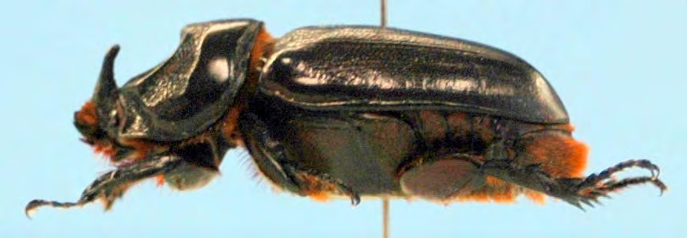



The coconut rhinoceros beetle invasion of Guam:
An unprecedented disaster
Aubrey Moore
Roland J. Quitugua
Trevor A. Jackson
Sean D.G. Marshall
Matthew Siderhurst
International Congress of Entomology, Orlando, Florida, Sept. 26, 2016

Slide 2
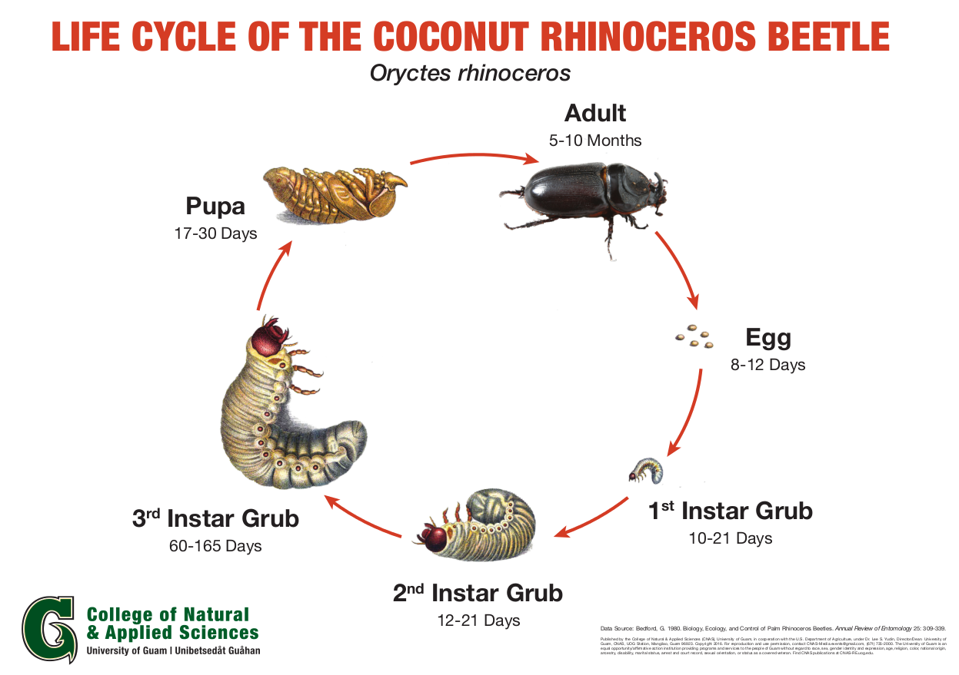

Slide 3
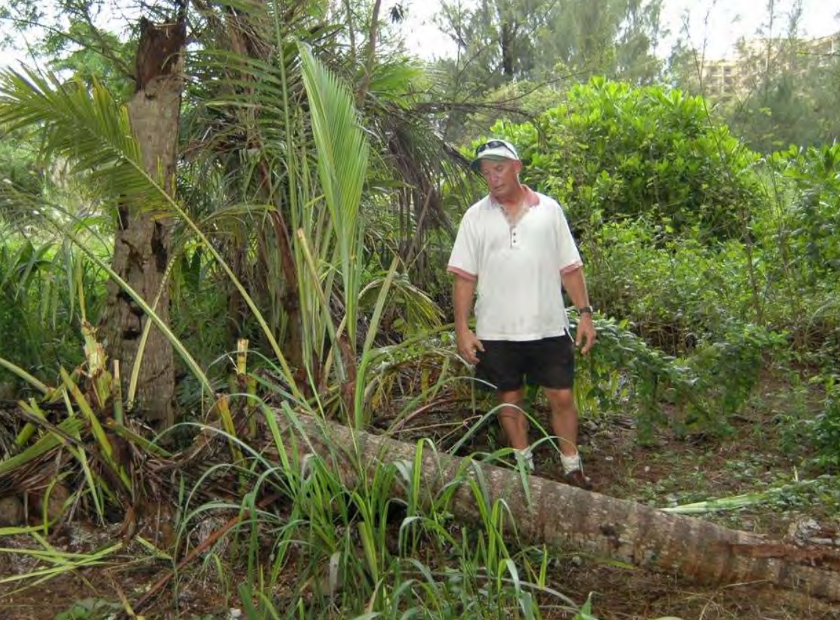

Slide 4
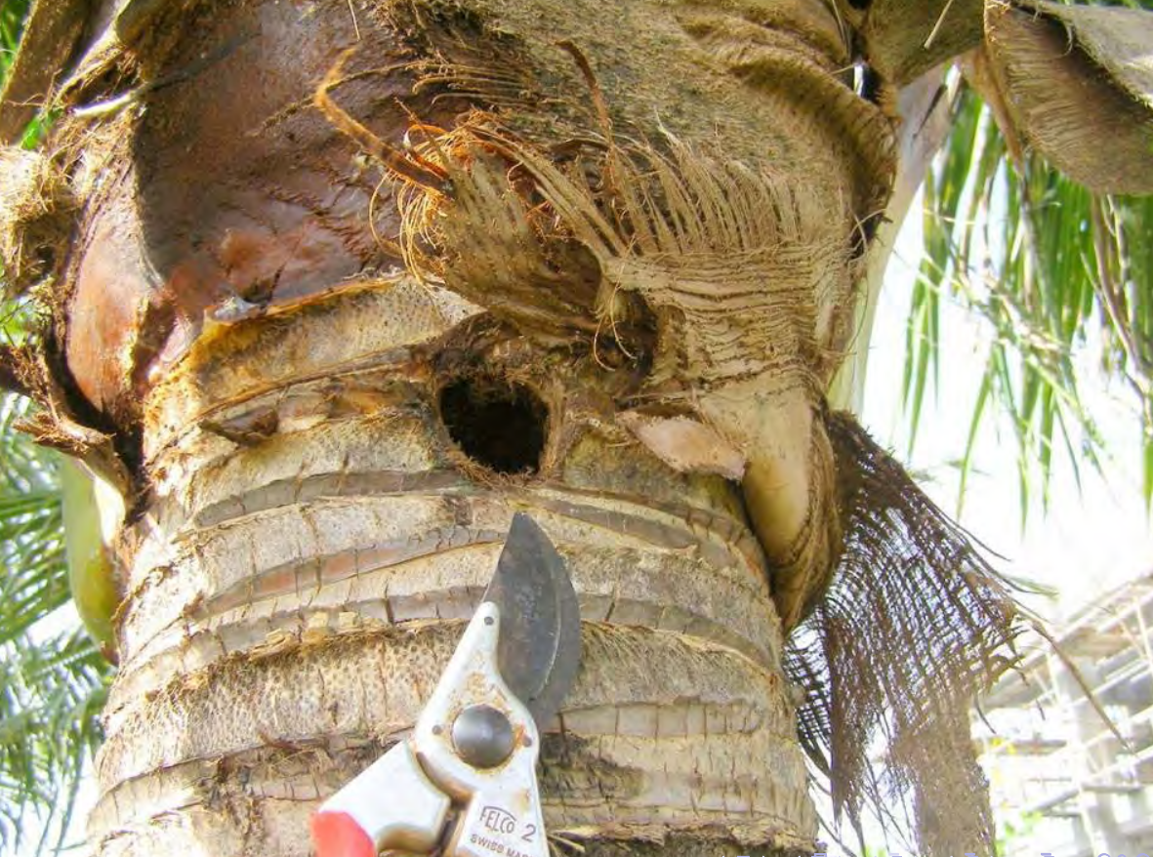
Notes:
- Adults bore into crowns of coconuts or other palms to feed on sap.
- Adults leave the bore hole after 2 or 3 days.
- Adults feed several times.
- Developing fronds are damaged when a beetle bores through them.
- Palms are killed if the meristem is damaged.
- Palms may regrow a full canopy of CRB damage is stoped. However, bore holes
do not heal, leaving palm structurally week and succeptible to beheading
strong winds.

Slide 5
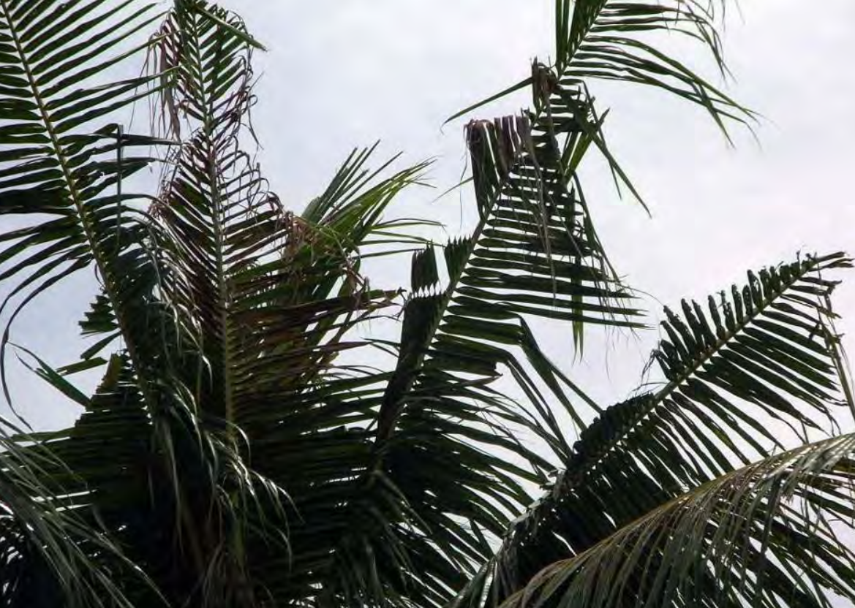

Slide 6
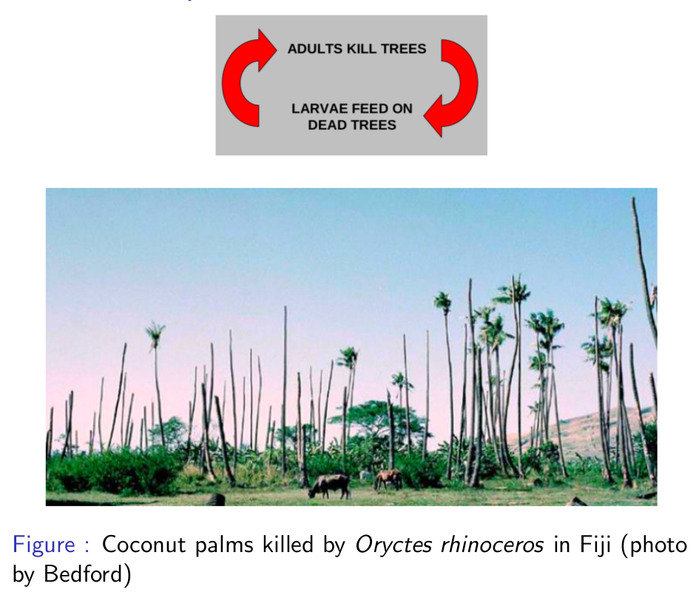

Slide 7
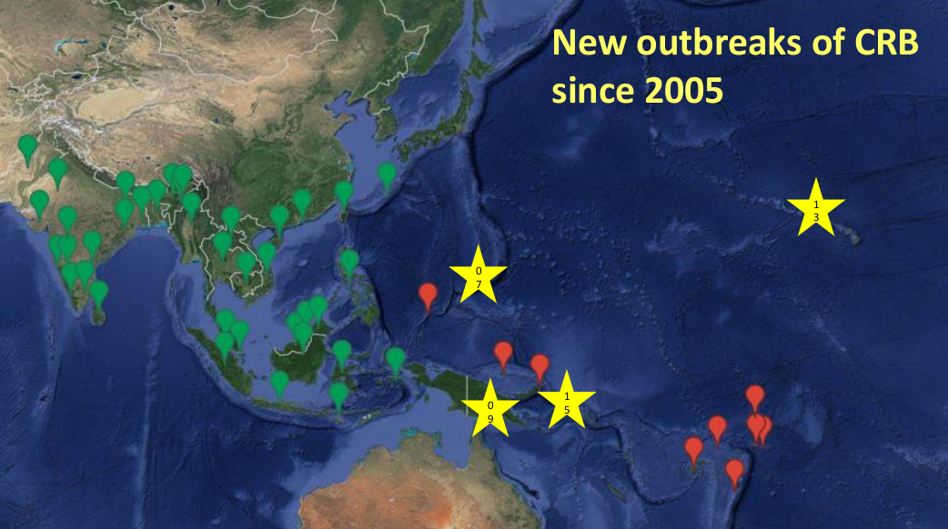
Notes:
- native range is SE Asia
- CRB arrived in the South Pacific with shipments of rubber plants from Ceylon
to Samoa in the early 1900s
- arrived in Palau during WWII
- no range expansion between 1975 and 2007
- only 1 successful eradication out of several attempts

Slide 8
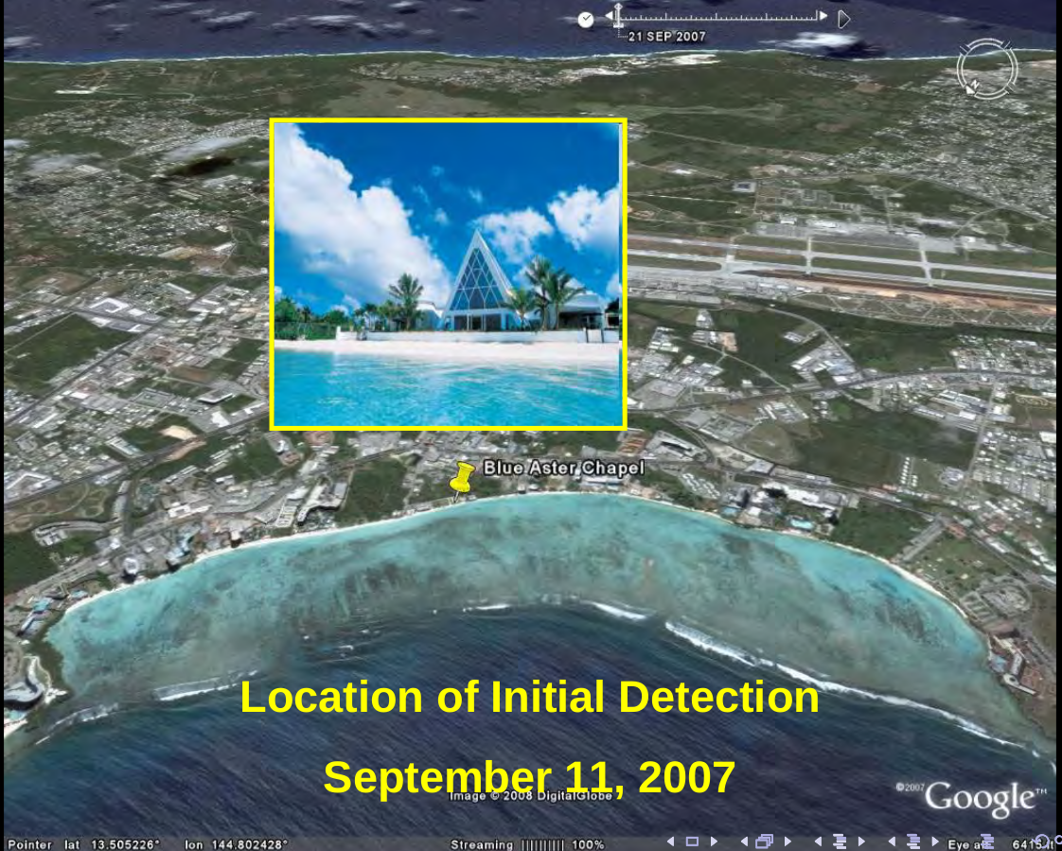

Slide 9
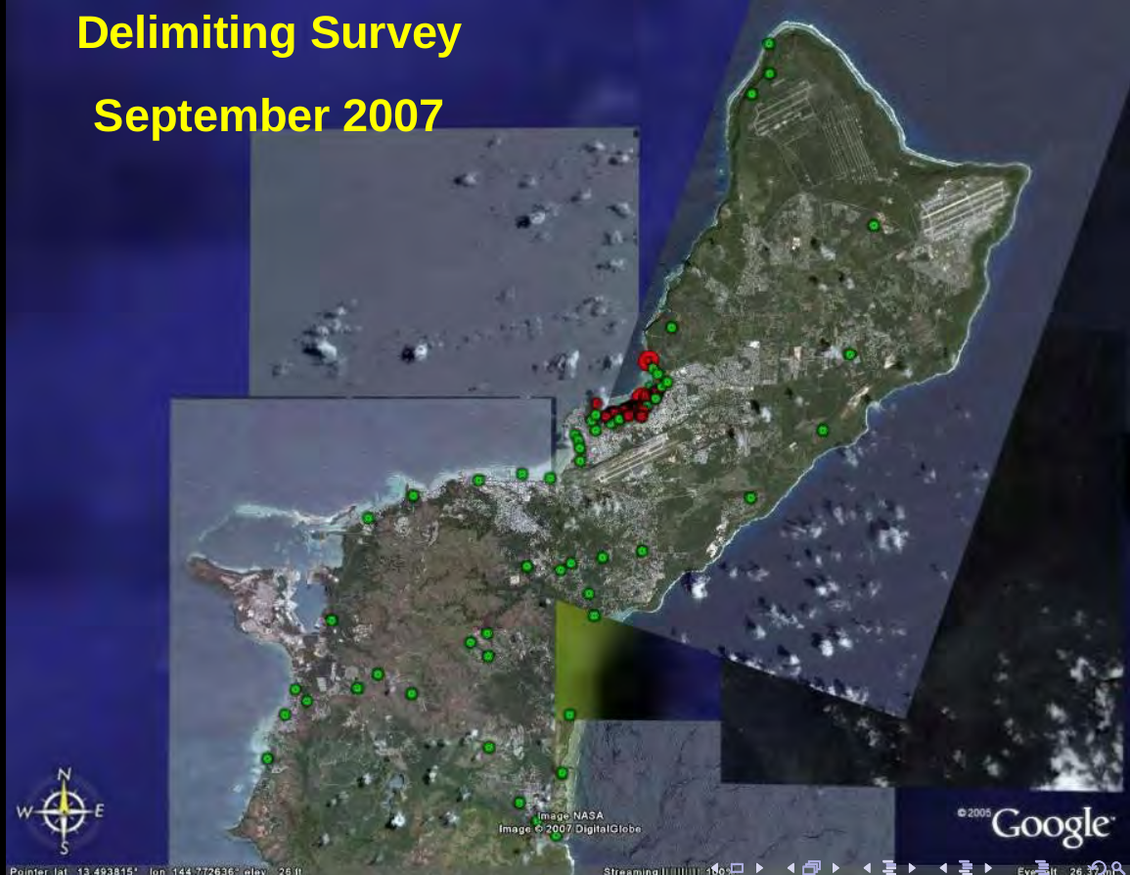

Slide 10
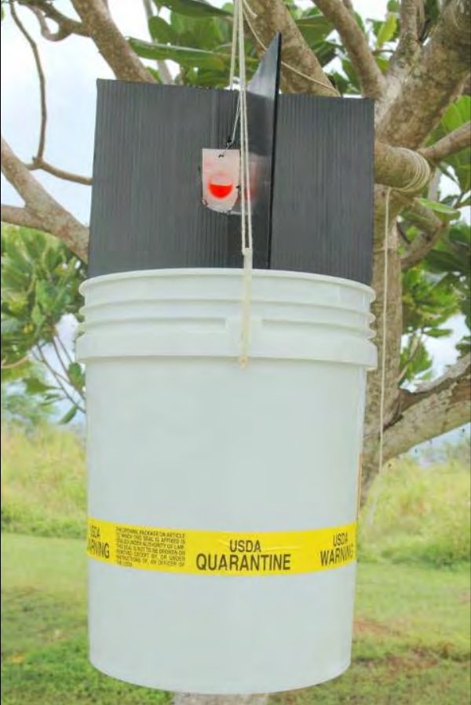

Slide 11
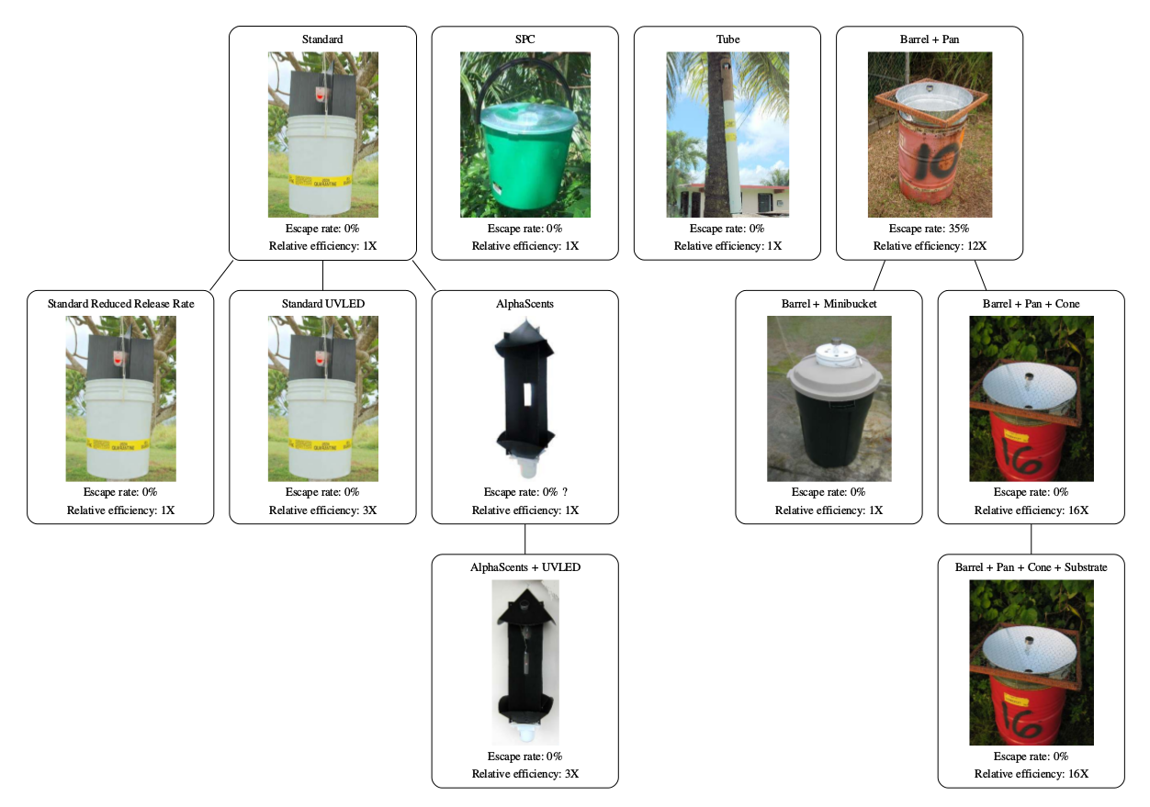

Slide 12
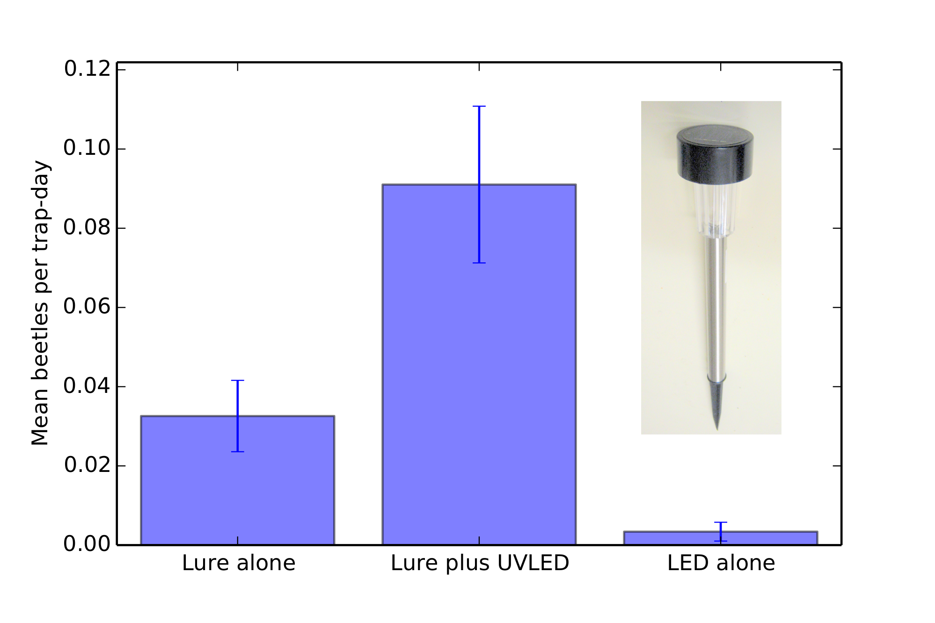

Slide 13
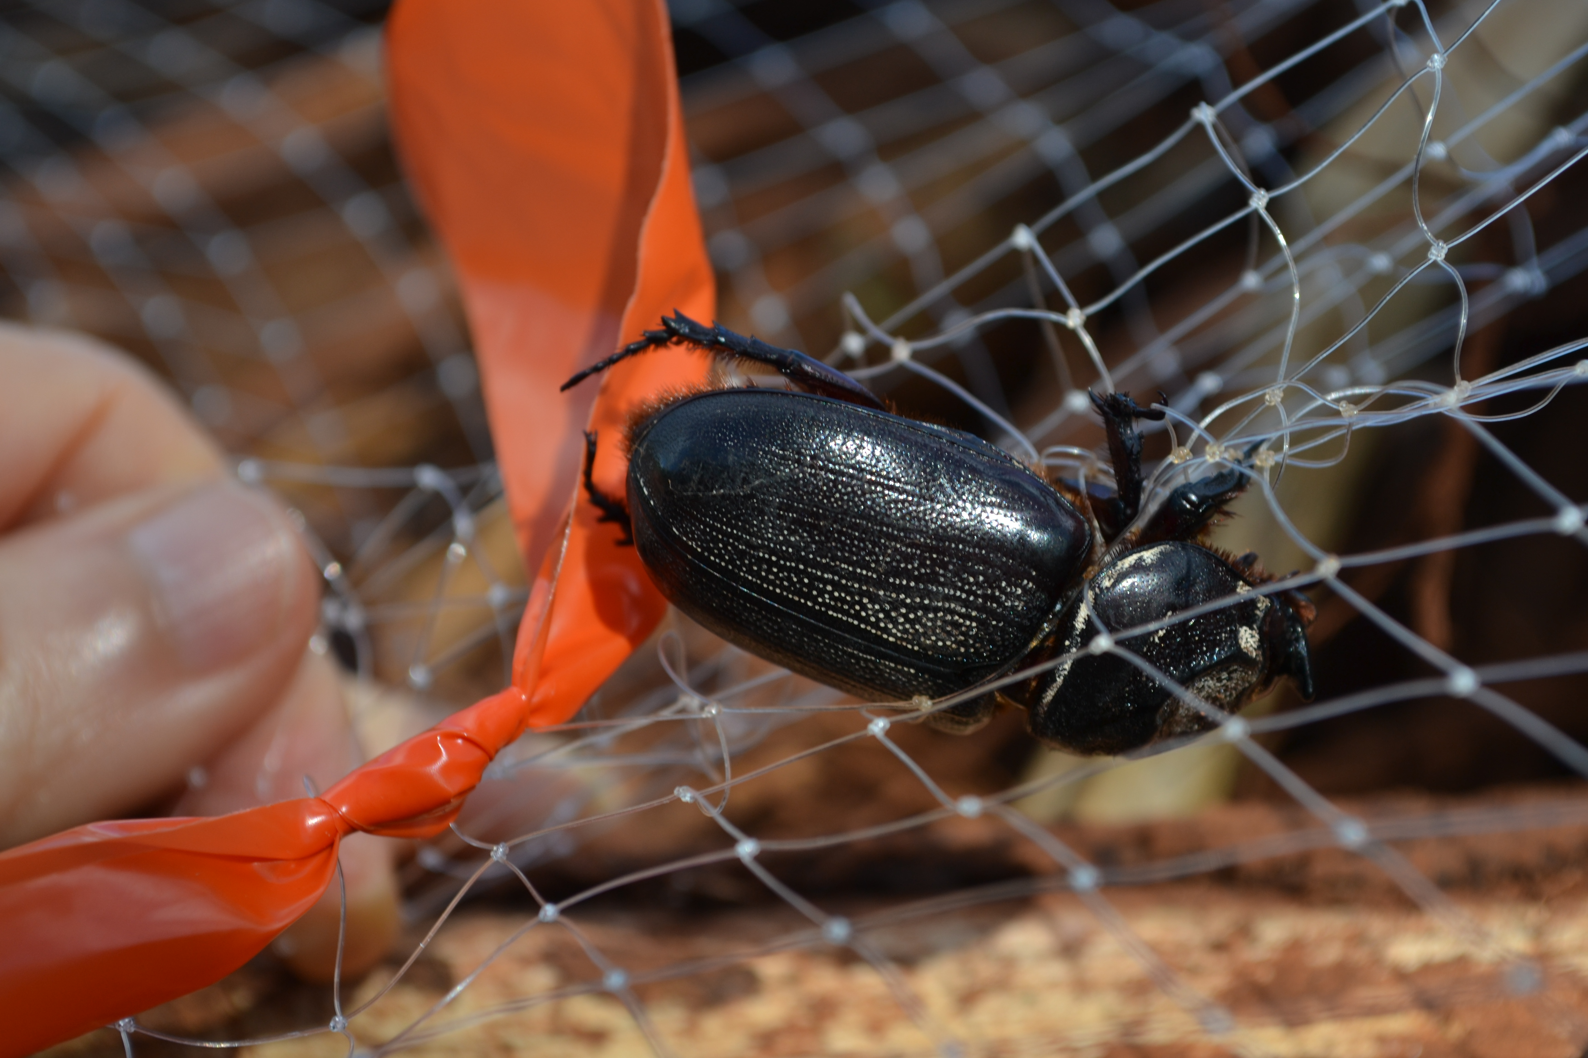

Slide 14
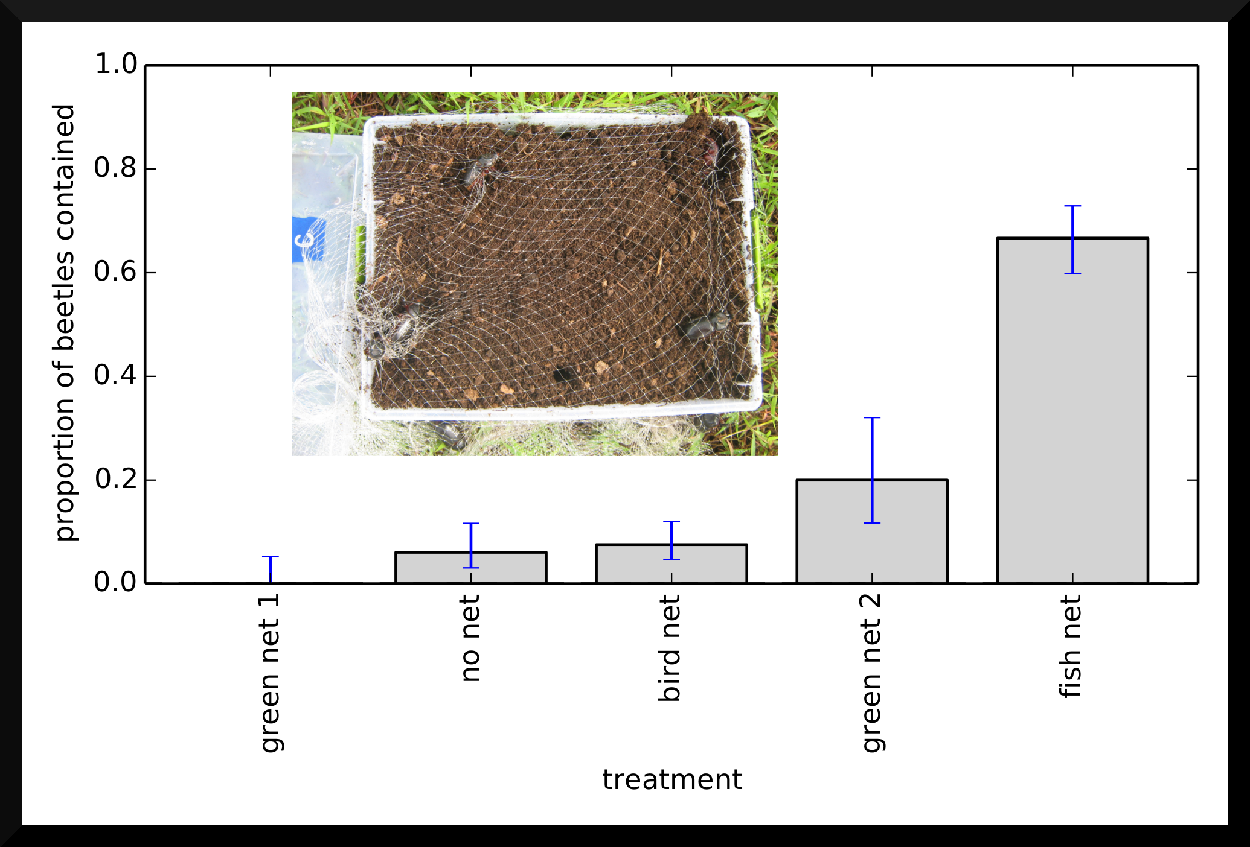

Slide 15
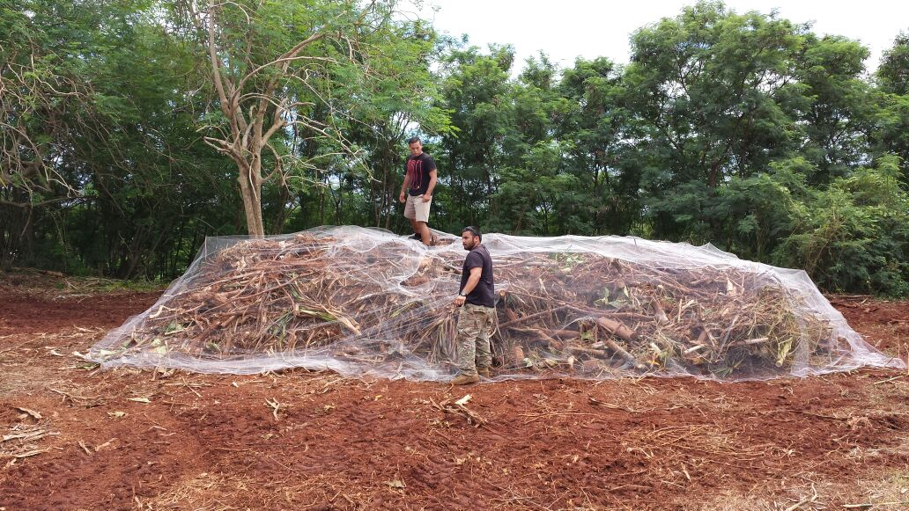

Slide 16
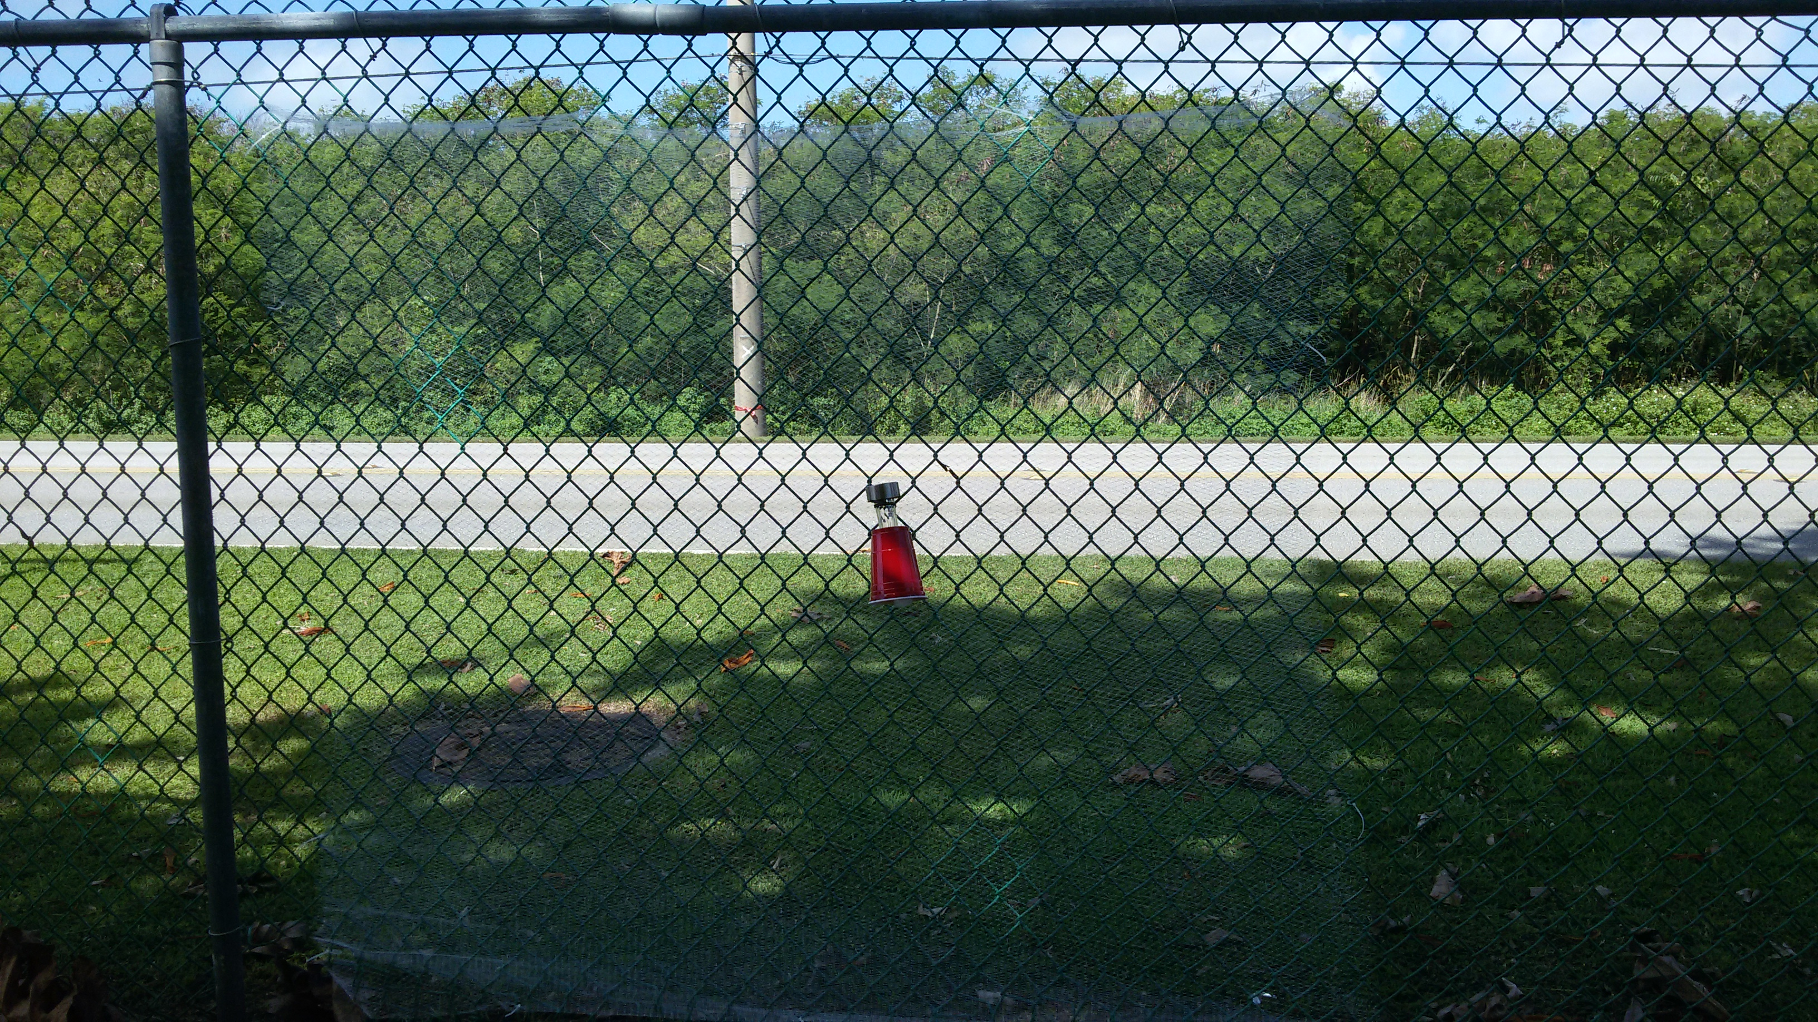

Slide 17
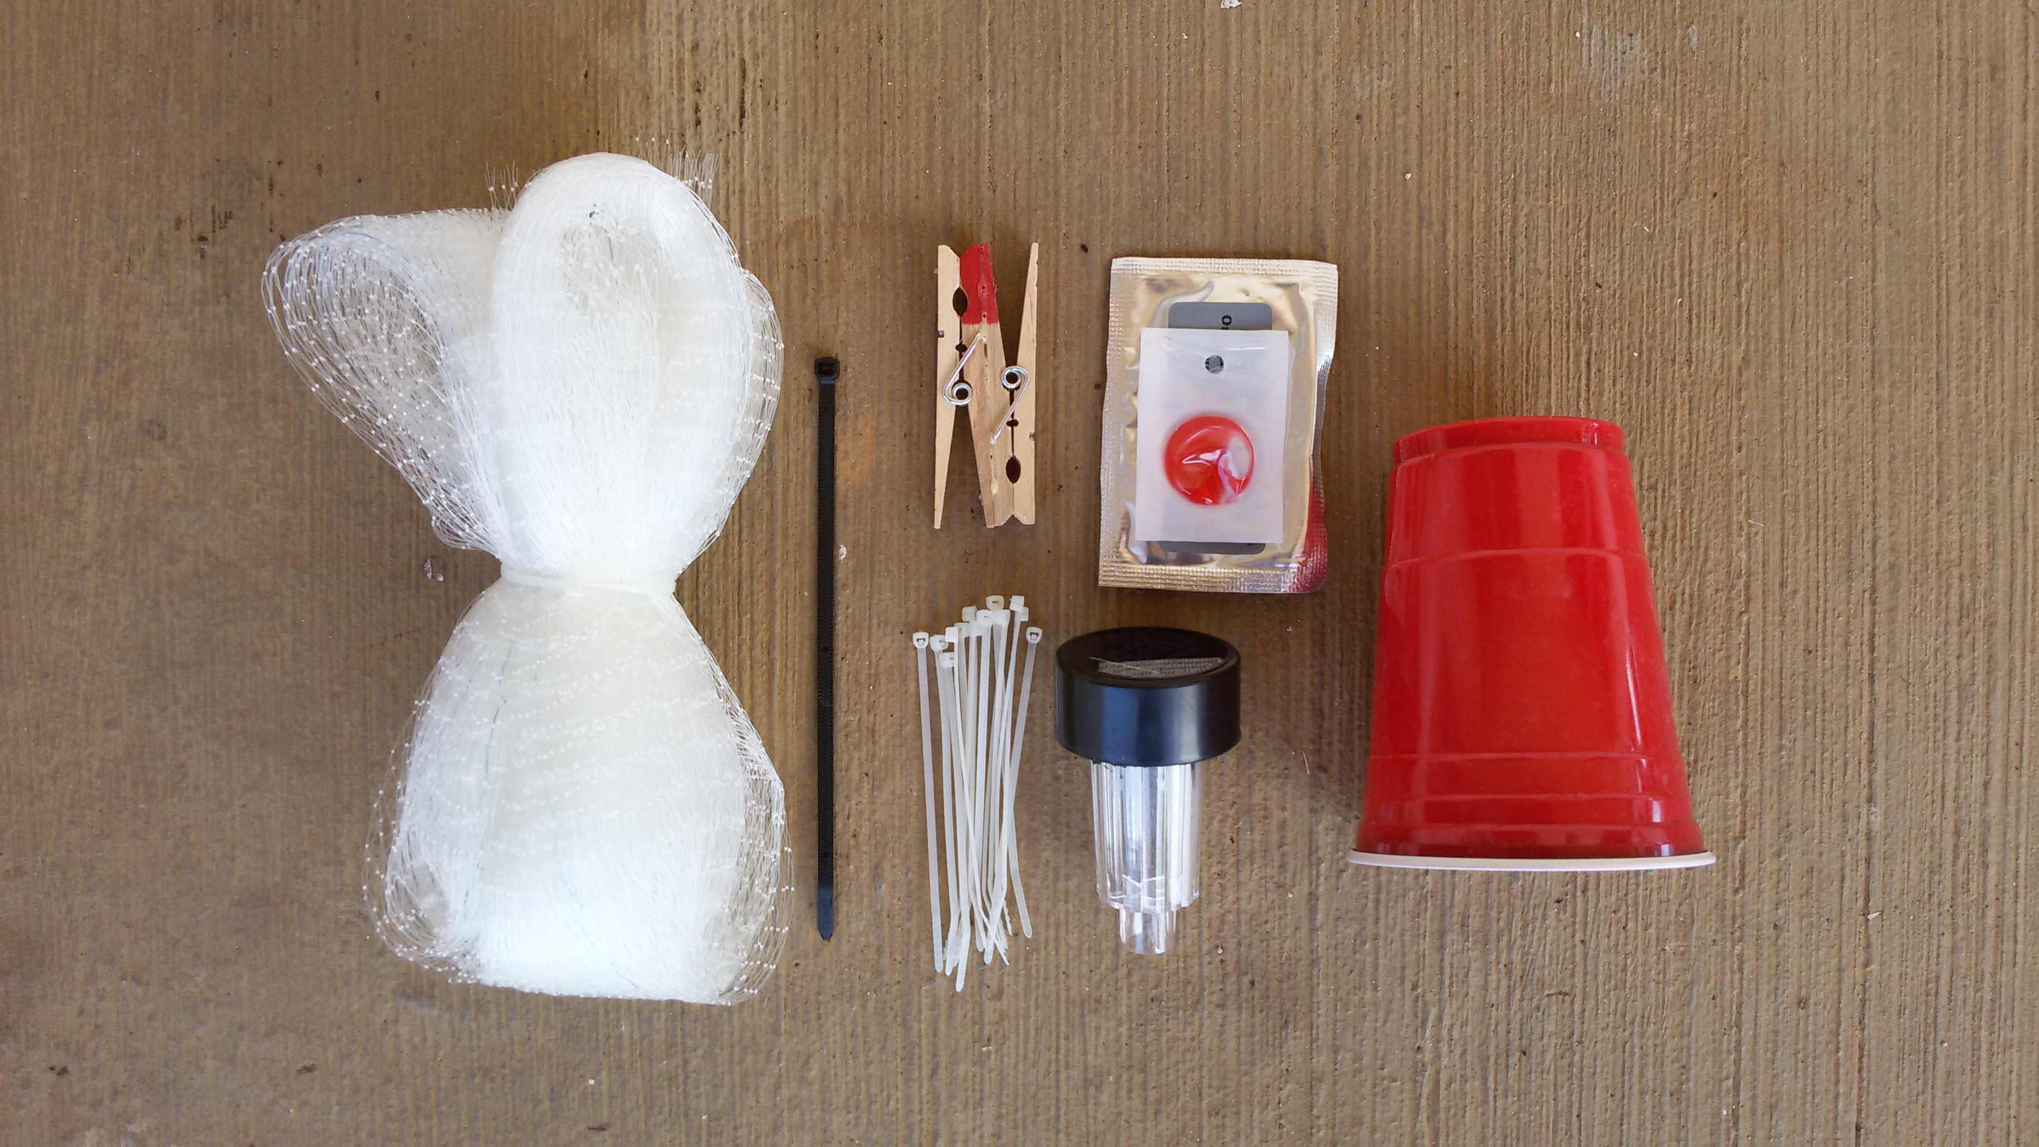

Slide 18
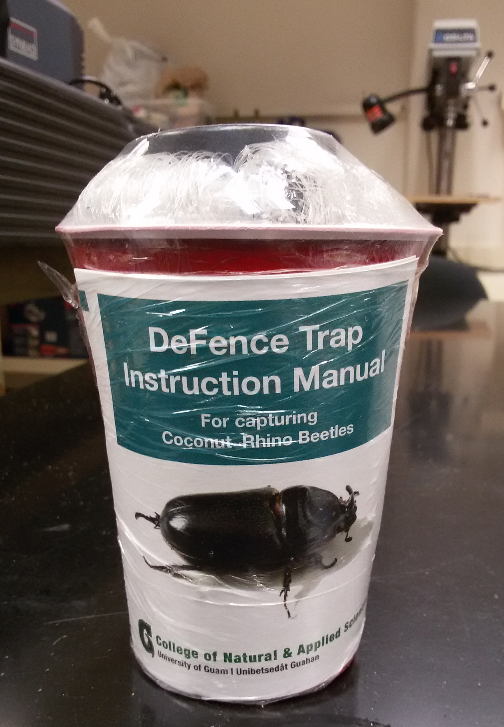

Slide 19
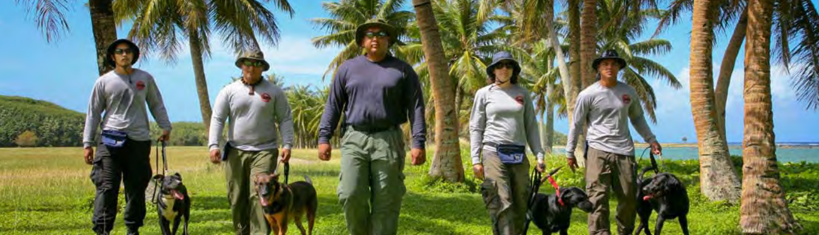

Slide 20
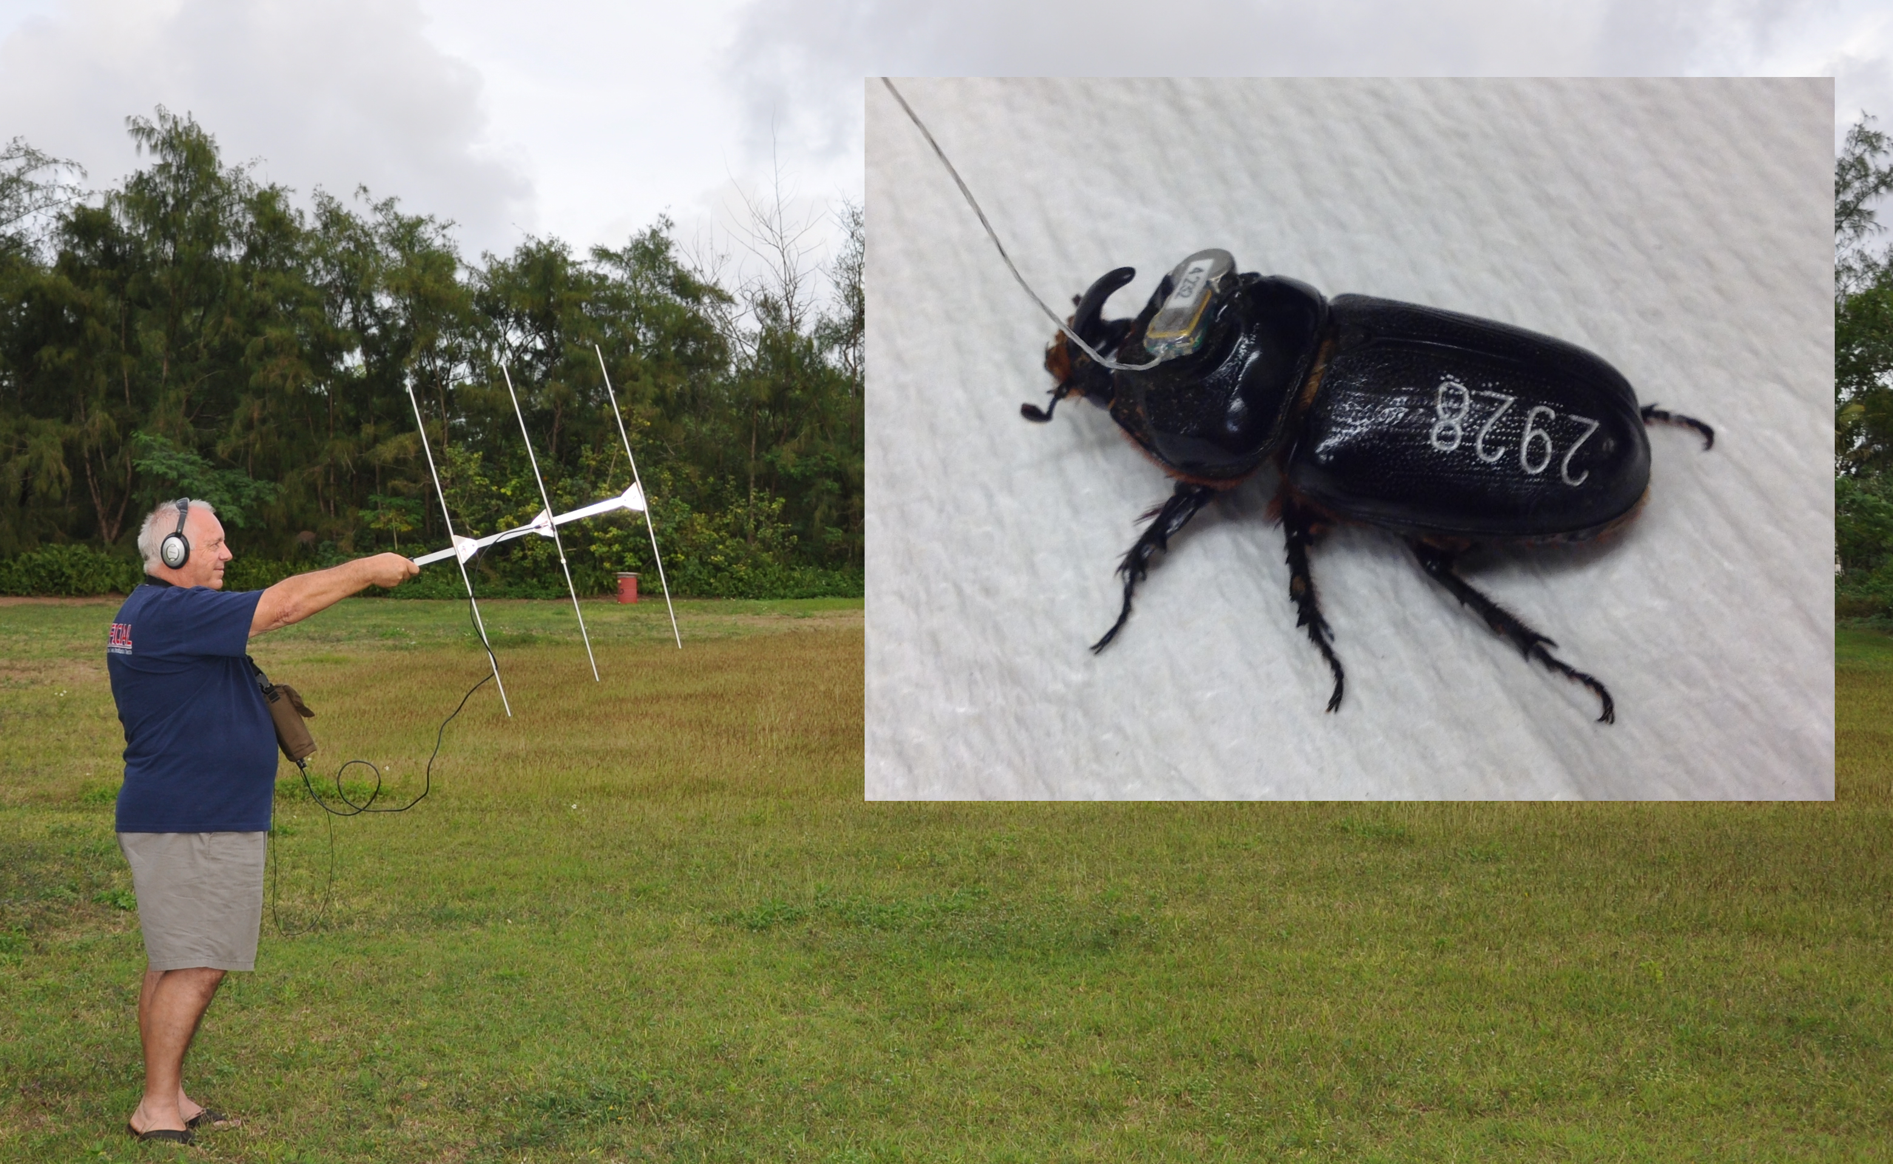

Slide 21
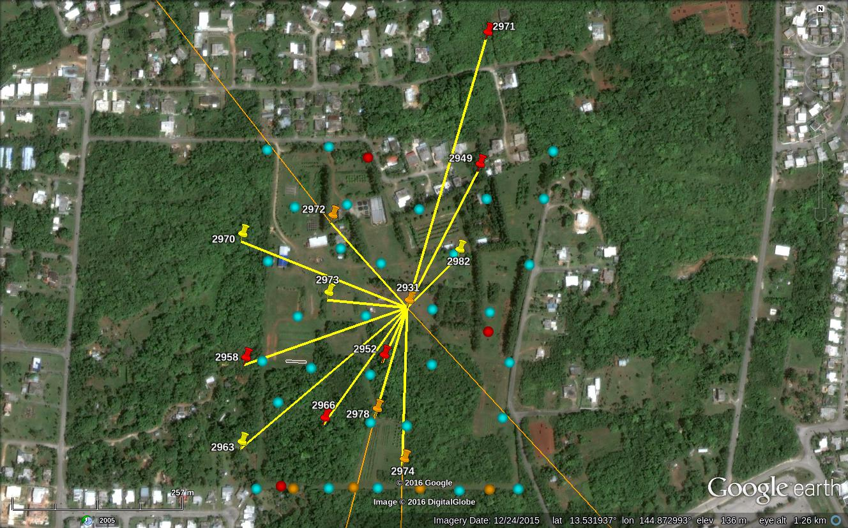

Slide 22
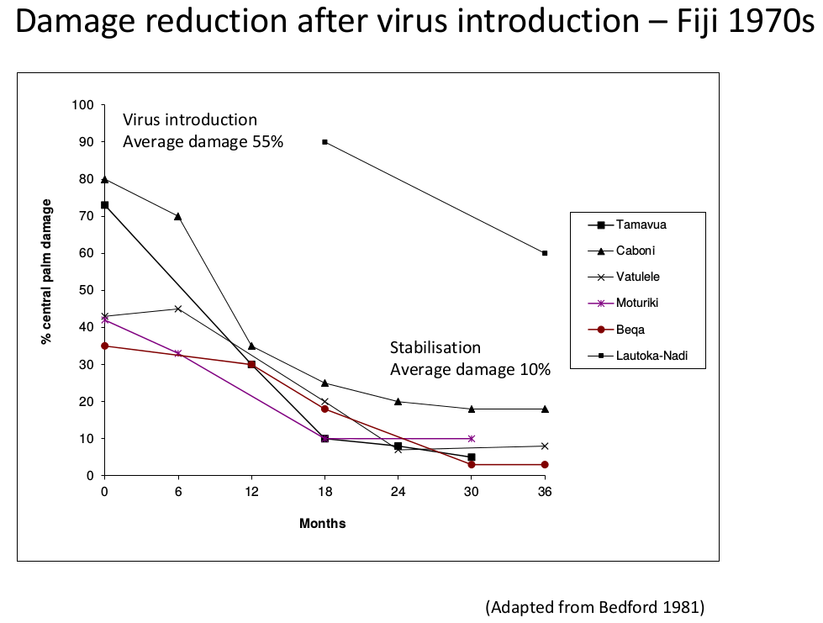

Slide 23
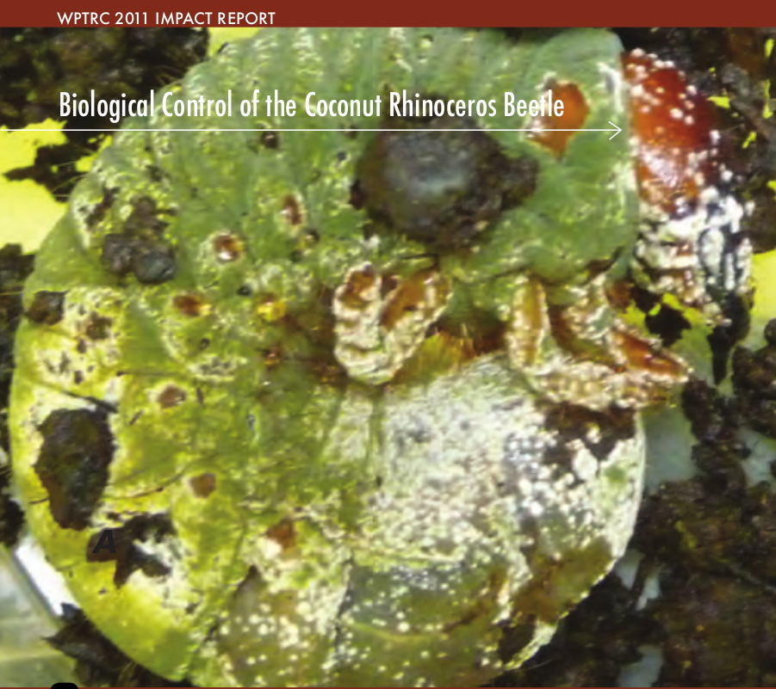

Slide 24
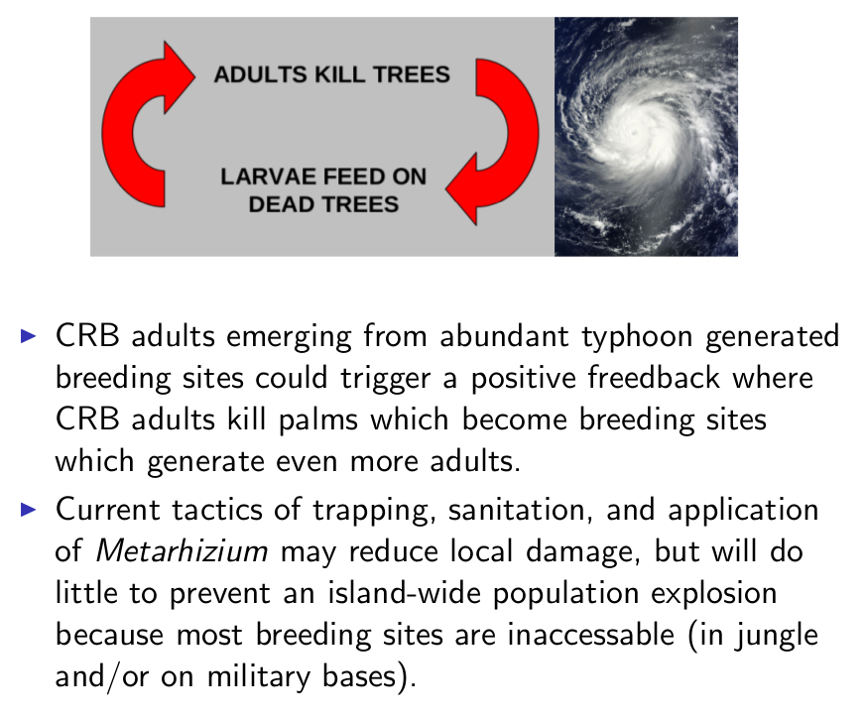

Slide 25
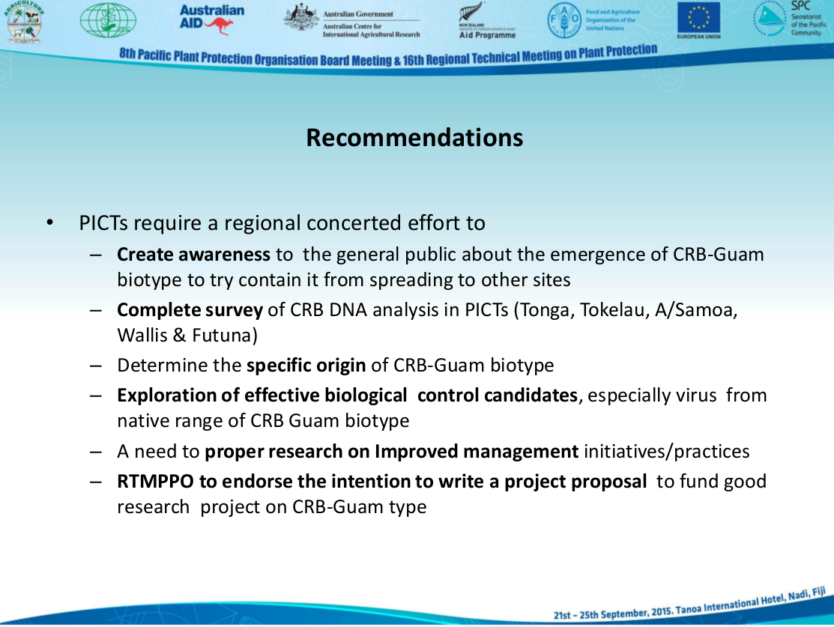

Slide 26
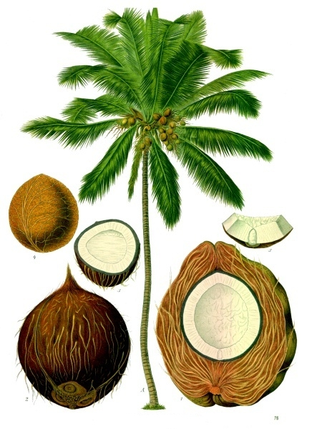
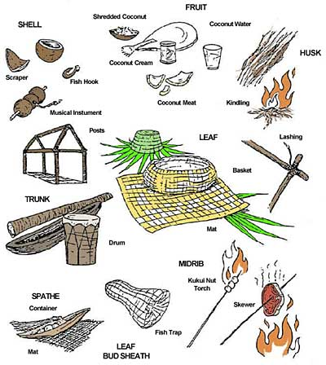

Slide 27
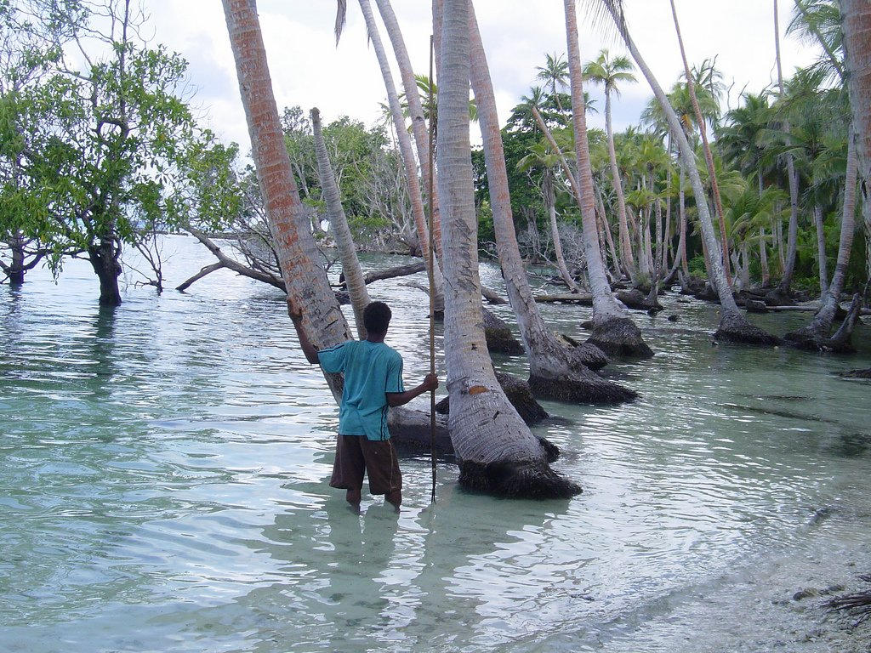

Slide 29
